Slide 1

Introduction of Ultra-wideband (UWB) Technology
Graham Zhu
Graham.zhu@nus.edu.sg

Slide 2
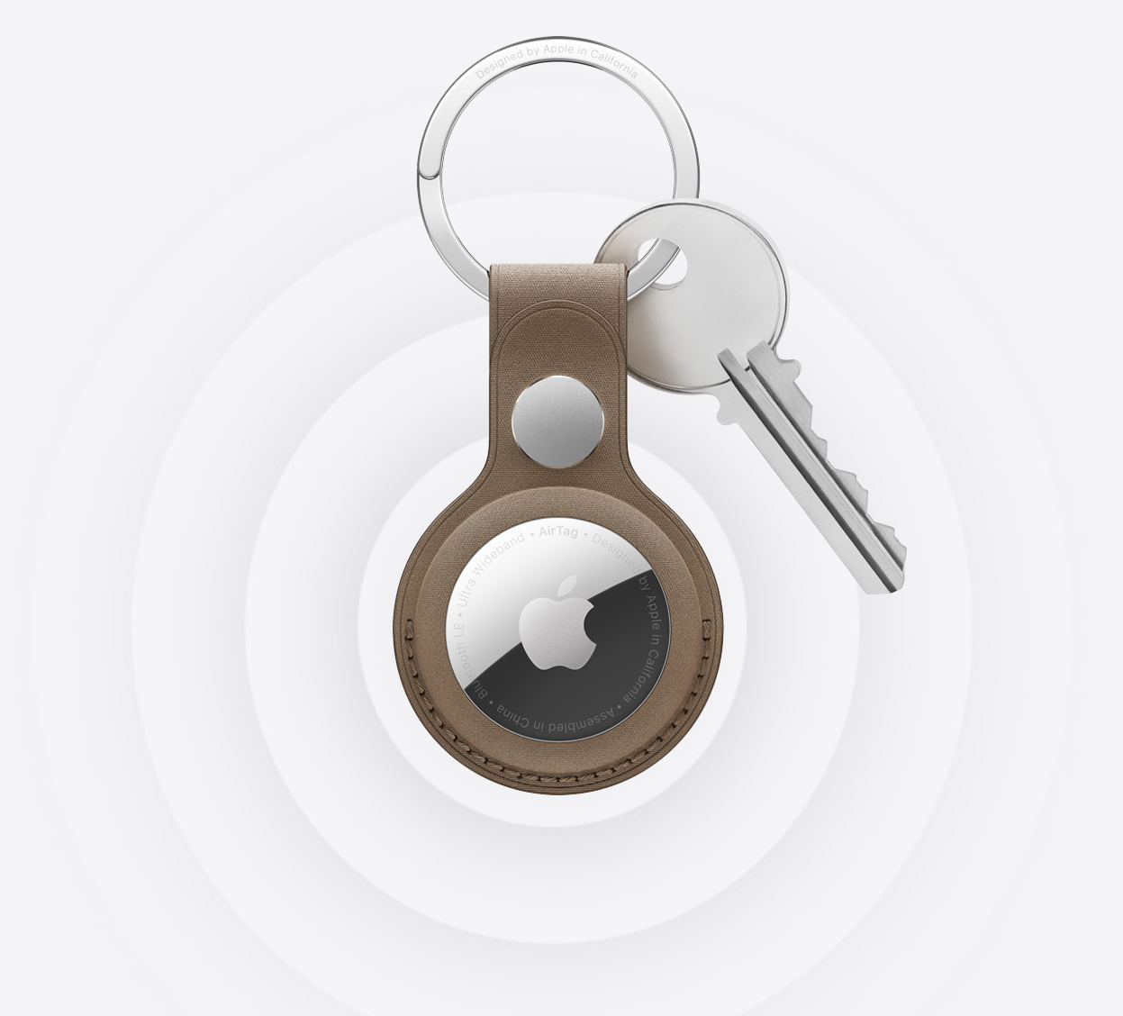

Slide 3
WHAT’S GOING ON FOR THE NEXT 2-3 HOURS
Introduction of Ultra-wideband(UWB)
History of UWB
What is Ultra-wideband(UWB)?
How does UWB work?
Use Cases for UWB
Hands-on workshop
Introduction to Murata UWB development board
Set up software work environment on computer
Communication between iPhone and UWB device

Slide 4
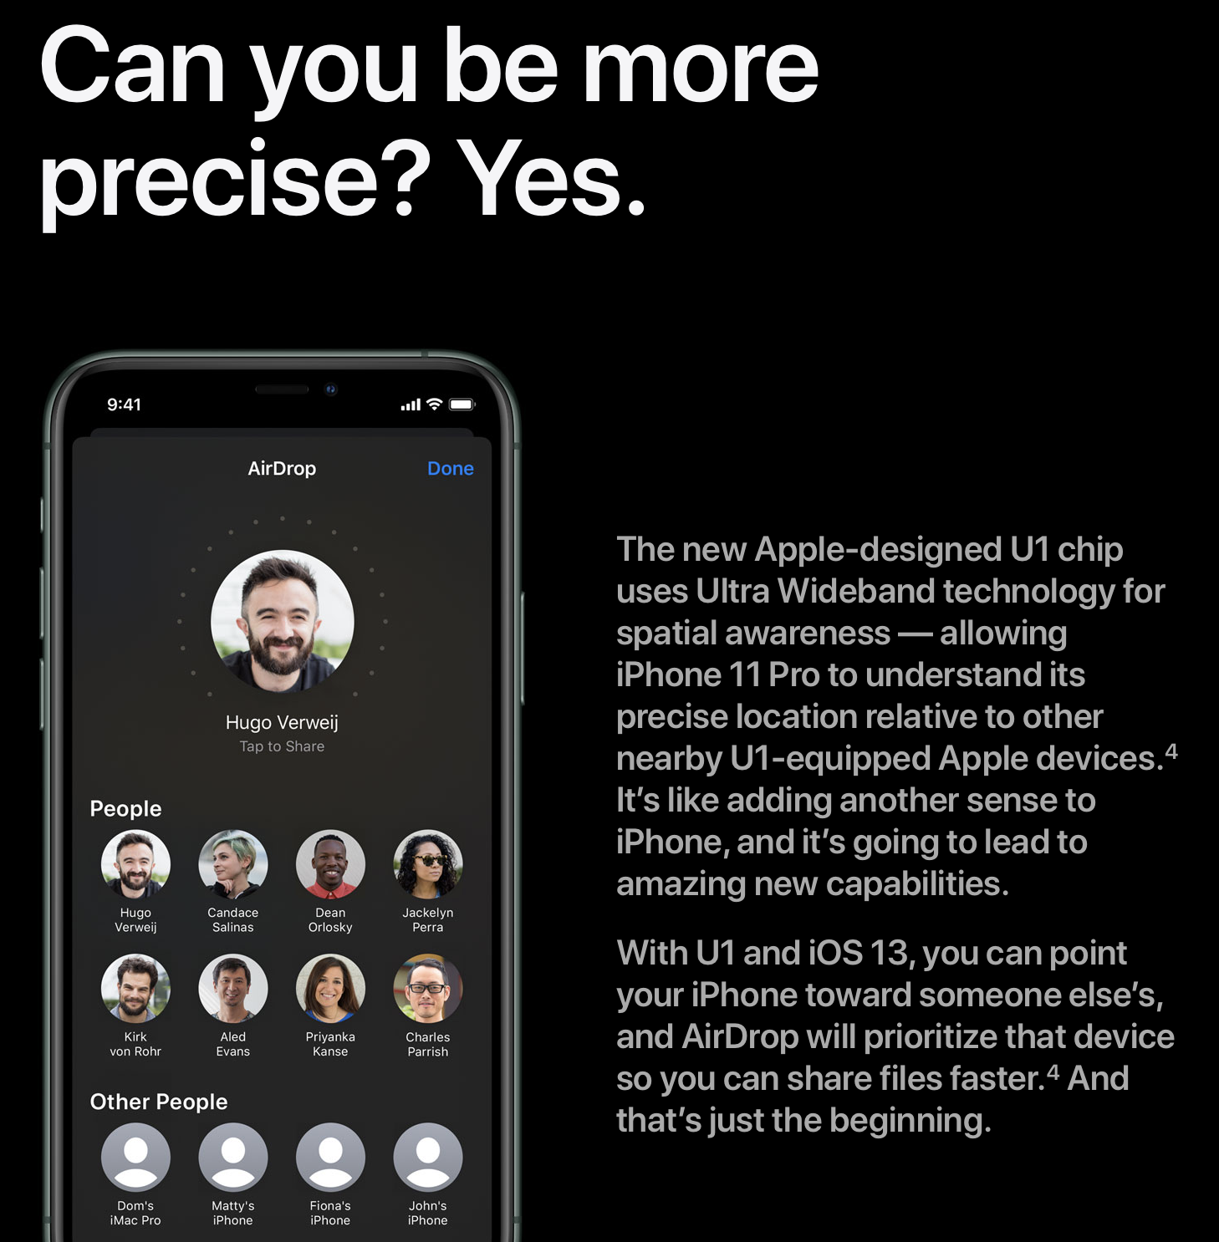
History of Ultra-wideband(UWB)
1960s – was researched primarily for military radar in the U.S.
<1994 – was classified as a military secret
2002 – was approved for civilian use
2019 – was well recognized by society
Apple-designed U1 TMKA75 UWB chip in iPhone 11
Enhanced AirDrop
Improved Directionality
UWB now in the hands of the consumer
Picture Source: iPhone-11-UWB.png (1458×1486)

Slide 5
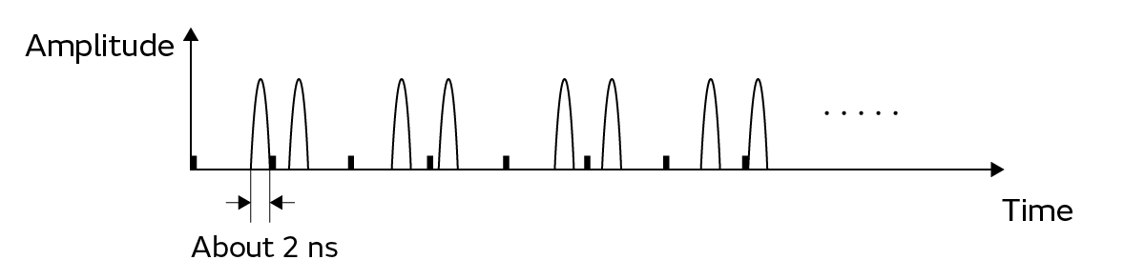
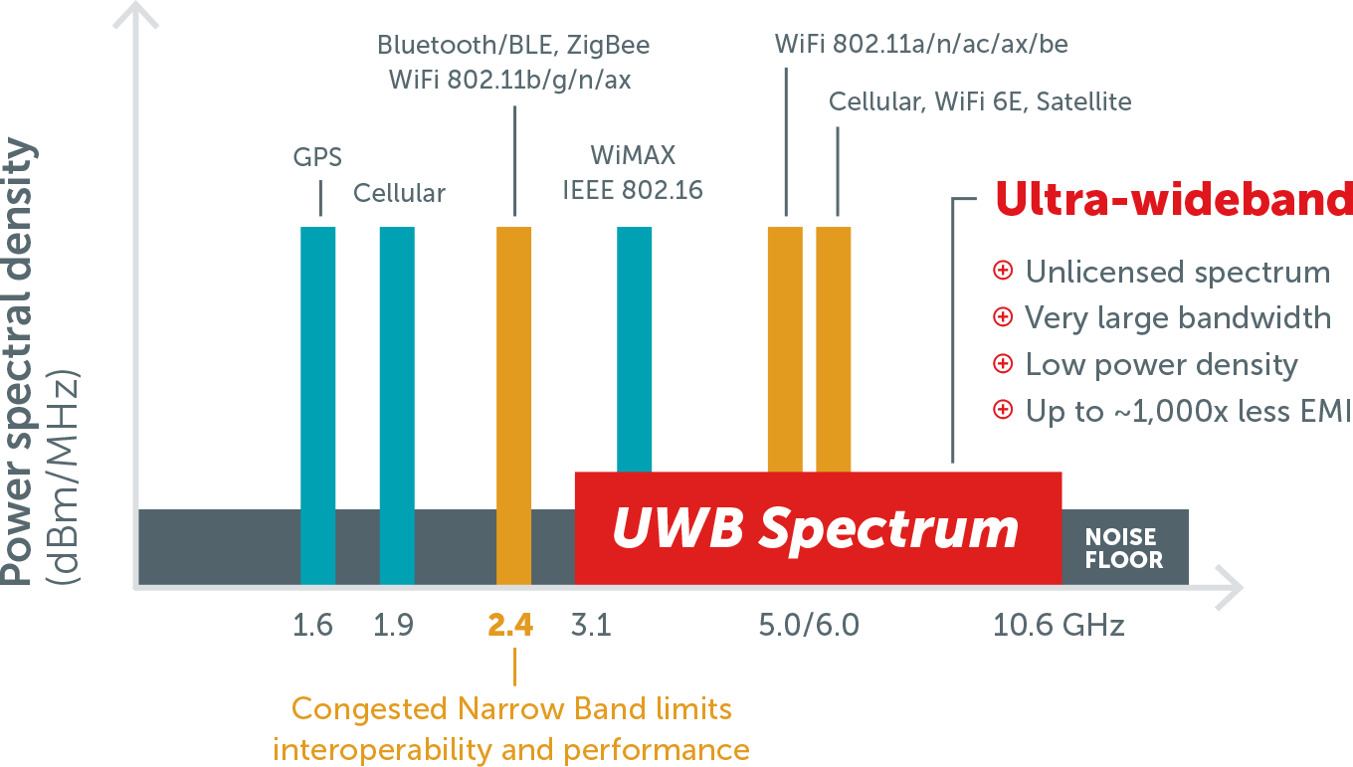
What is Ultra-wideband (UWB)?
UWB is a wireless communication technology that operates over a wide frequency spectrum
Uses impulse radio with extremely short pulses (~2ns)
Has a very low power spectral density
Operates in typical 3.1 - 10.6 GHz range
Uses very wide channels(at least 500 MHz)
Data rates of up to 27 Mbps (Bluetooth: 3Mbps Max)
Enables measurement of Time of Flight(ToF) of radio signals with sub-meter accuracy for ranging/location services and close-proximity communications
Picture Source: Spark Ultra-Wideband Technology | Spark UWB SPARK microsystems

Slide 6
Features of UWB
High-precision ranging and positioning
High Security
Low Interference with other communications
Low power consumption

Slide 7
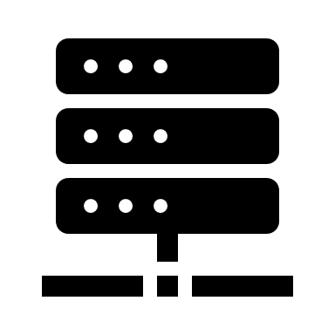
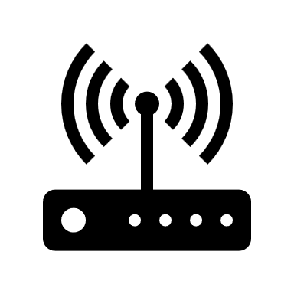
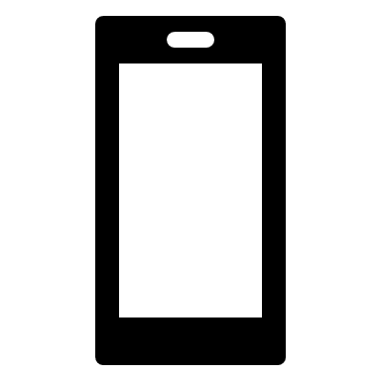
How does UWB Ranging & Localization work?
UWB Ranging & Localization Components
Anchor (Fixed Unit) – Measures location of Mobile Units
Tag (mobile unit) – in motion
Location engine/server
Virous Algorithms for Measurement
Location Engine/Server
Anchor
Tag
Anchor
Anchor

Slide 8
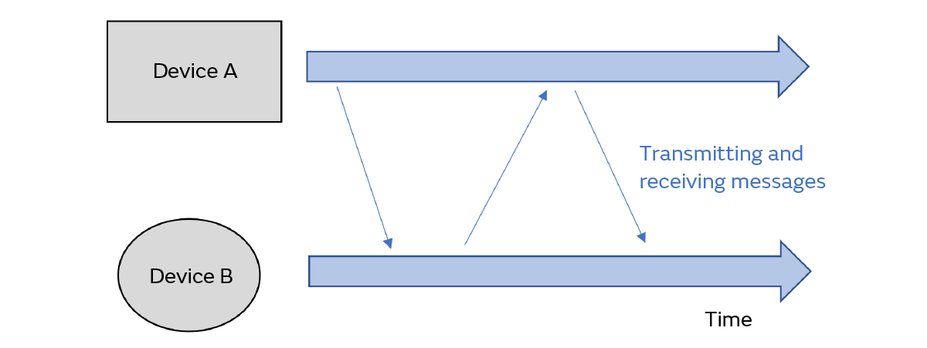
UWB Ranging & Localization Algorithm
Time of Flight (ToF)
SS-TWR (Single-sided Two-Way Ranging)
Clock synchronization is required
DS-TWR (Double-Sided Two-Way Ranging)
No clock synchronization is required
Simpler and higher precision measurement
Time Difference of Arrival (TDoA)
Anchor
Tag
Anchor
Anchor

Slide 9
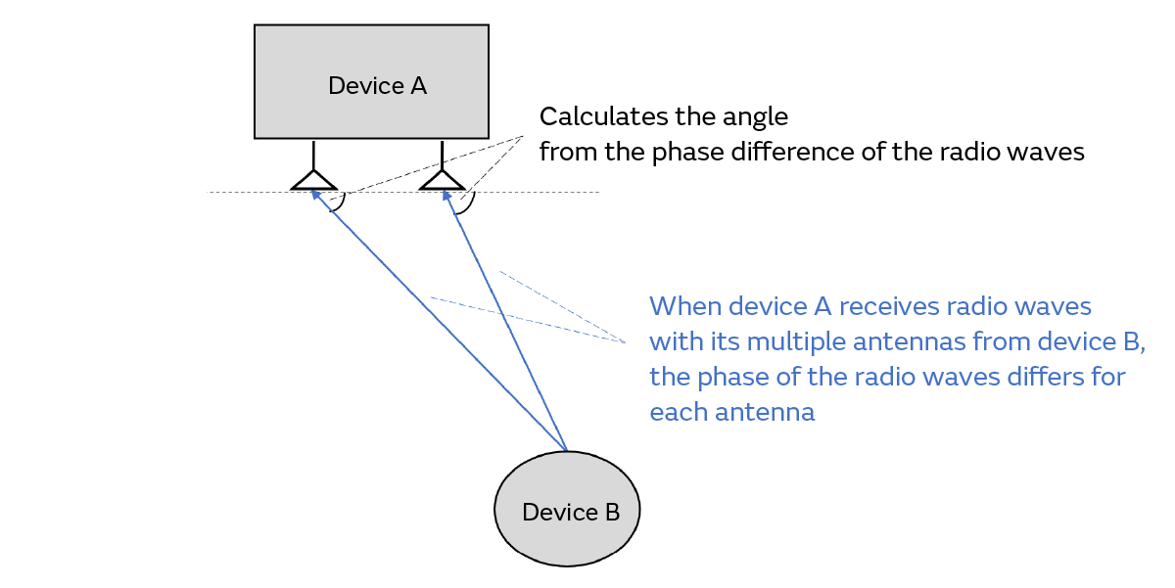
UWB Ranging & Localization Algorithm
Angle of Arrival (AoA)
2D AoA with 2 Antennas
3D AoA with 3 Antennas
Anchor
Tag

Slide 10
Applications of UWB
Secure Access Control
Smart car access with smartphone for keyless entry and remote start
Can be combined with BLE for wake-up/initialization prior to secure ranging.
Secure Wireless payments
More secure than NFC, and can leave smartphone in the pocket
Location-based Services
Asset tracking in high density environments
Proximity of small objects
Sports & Fitness Tracking
Tracking of players and athletes on a field/arena
Healthcare
Medical radar
Wireless Health sensors(WBAN)
Automotive
Wireless in-vehicle Networks
Smart Keys
Source: Spark Ultra-Wideband Technology | Spark UWB SPARK microsystems

Slide 11
Application for B&O products
Locating speakers in the room
Directional or Spatial Sound
What is Your Idea?

Slide 12
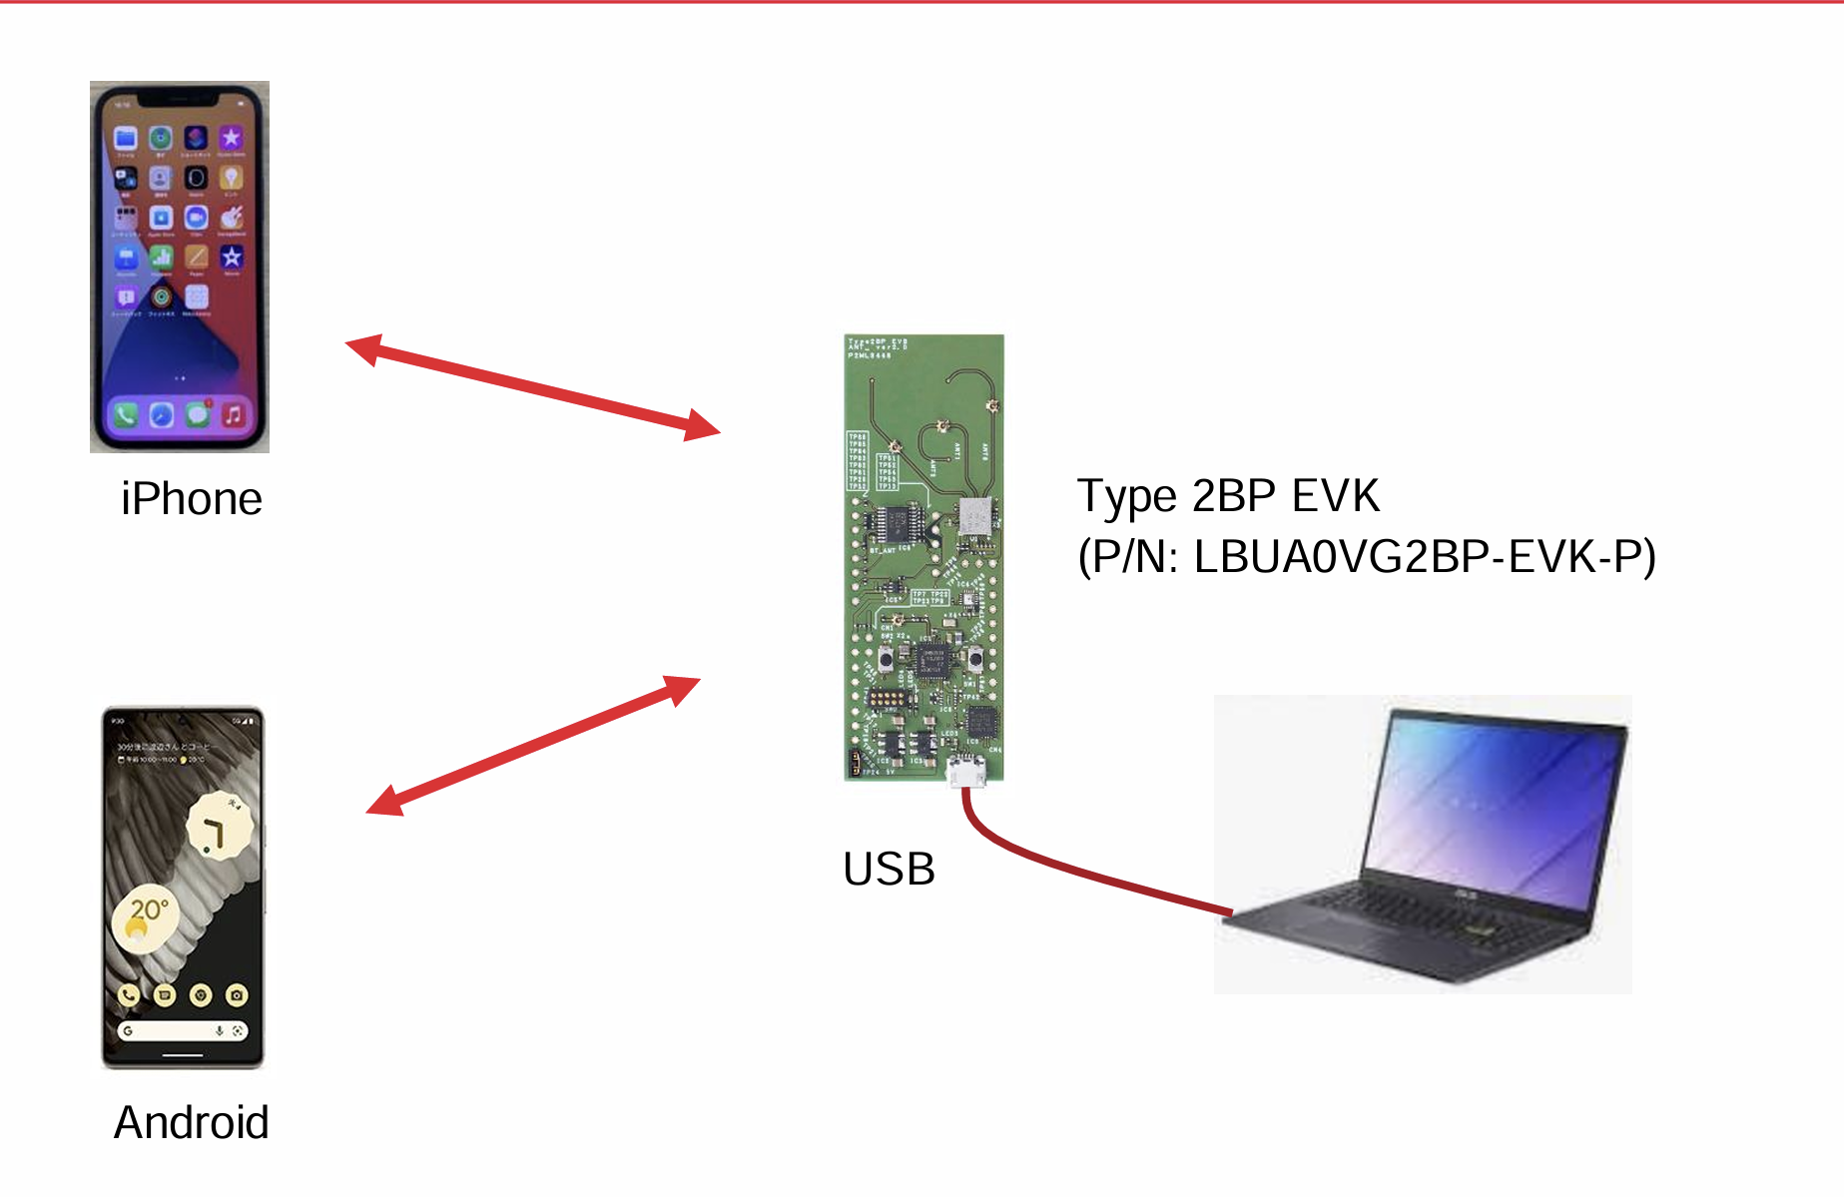
Hands-on Workshop

Slide 13
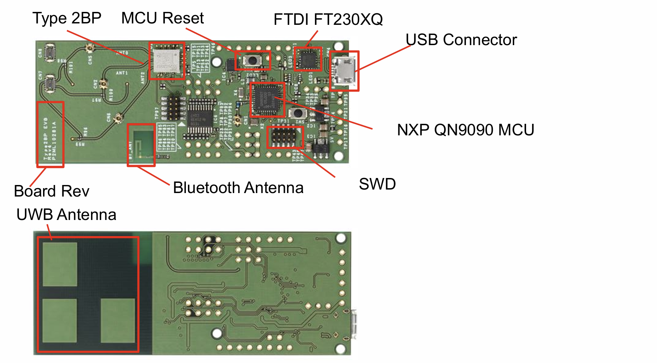
Murata Type 2BP Evaluation Board

Slide 14
Workshop
python3 -m ensurepip
Go to the following Github link for instructions:
https://github.com/GrahamZhu-NUS/UWB-Workshop

Slide 15
What can be done Next?
Try more sample code and development instructions on "My Murata" Website
Develop Apps for UWB application
For IOS
For Android

Slide 16
THANK YOU

